Slide 1
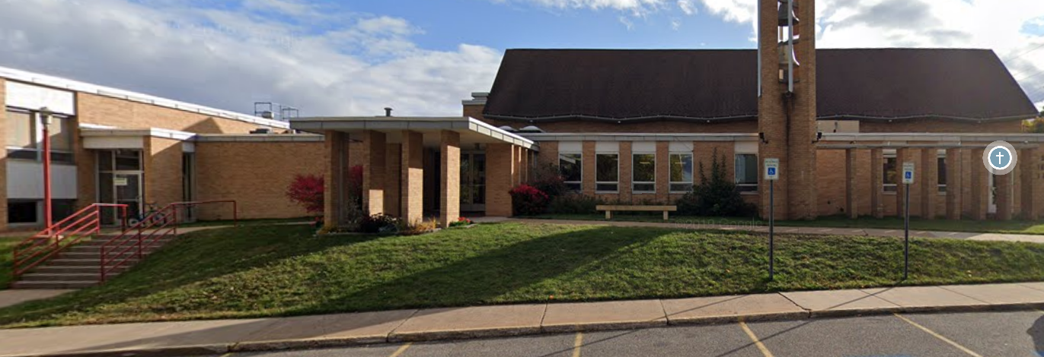
Serenity Now
Alcoholics Anonymous Early Morning Meeting
Location: Messiah Lutheran Church
305 W Magnetic Street, Marquette
Time: 7:00 a.m. to 8:00 a.m.
Monday, Wednesday, and Thursday
Format: Open
Schedule: Monday – Big Book “Readtime”
Wednesday – The Twelve Promises
Thursday – The Twelve Steps
Parking is available on Magnetic Street in front of the church
Contacts: Laura lkagy@greatlakesrecovery.org
906-458-7161
Vince vincenystrom@gmail.com
734-255-7167

